Slide 1
Simulation of GoBack N Protocol
Harsh Rajput (2022201) Aryan Single (2022112)

Slide 2
Using Threads for Network Entity Simulation
Why Threads? Threads are ideal for simulating network entities that produce and consume packets at random intervals.
Producer (Network Entity): Generates packets at random intervals, adding them to a shared queue. This simulates real-world, asynchronous packet generation.
Consumer (Data Link Entity): Continuously checks the queue to process packets (e.g., sending over a network) as they arrive, working concurrently with the producer.
Concurrency with Threads: Threads allow producer and consumer to operate simultaneously, modeling real-world network behavior without blocking each other.
Queue for Synchronization: Uses queue.Queue, a thread-safe queue, to manage packets safely between threads, preventing race conditions.
Why Not Processes? Threads are more efficient for I/O-bound tasks, sharing memory easily and using fewer resources than processes.

Slide 3
NetworkEntity Class (Producer)
Purpose: Simulates a network entity that produces packets at random time intervals and adds them to a shared queue.
Methods:
__init__(self, packet_queue, T1, T2, max_packets=10000)
packet_queue: Queue for placing packets.
T1, T2: Define random delay range between packet generations.
max_packets: Sets the limit for total packets generated.
run(self)
Starts generating packets until reaching max_packets.
Pauses between packets with random intervals using random.uniform(T1, T2).
Adds each packet to packet_queue.
generate_packet(self)
Generates a packet (e.g., a simple string "Packet" or more complex data in real use).

Slide 4
DataLinkEntity Class (Consumer)
Class Purpose: Simulates a data link entity that consumes packets from a queue, sends them, and manages acknowledgments.
Key Methods:
__init__(self, socket, address, packet_queue, entity_name, start_time, ...)
Initializes with network parameters, including a packet queue and probability P for packet drop.
run(self)
Continuously consumes packets from the queue, processes them, and checks for ACKs.
send_packet(self, packet) and drop_packet(self)
Simulates sending a packet, with a drop rate based on probability P.
receive_packet(self)
Simulates receiving packets or ACKs, updating sequence numbers accordingly.

Slide 5
Main Code Execution
Setup for Network Simulation:
Sockets: Two UDP sockets simulate independent communication channels.
Queues: Two queues manage packets for producer-consumer interactions.
Initialization of Entities:
NetworkEntity Instances (Producers): Generate packets at random intervals.
DataLinkEntity Instances (Consumers): Simulate receiving and processing packets, responding with ACKs.
Concurrency with Threads: Each entity runs in its own thread, allowing asynchronous operation and independent packet handling.

Slide 6
Simulation Flow & Network Behavior
Simulation Steps:
Packet Generation: Producer threads generate and queue packets.
Packet Consumption: Consumer threads process packets asynchronously.
Concurrency & Asynchronous Behavior:
Producer and consumer operate concurrently, simulating network traffic.
Sliding Window Protocol: Manages packet sequencing and ACKs, modeling reliable transmission.
Network Effects:
Random delays and packet drops simulate real-world network conditions.

Slide 7
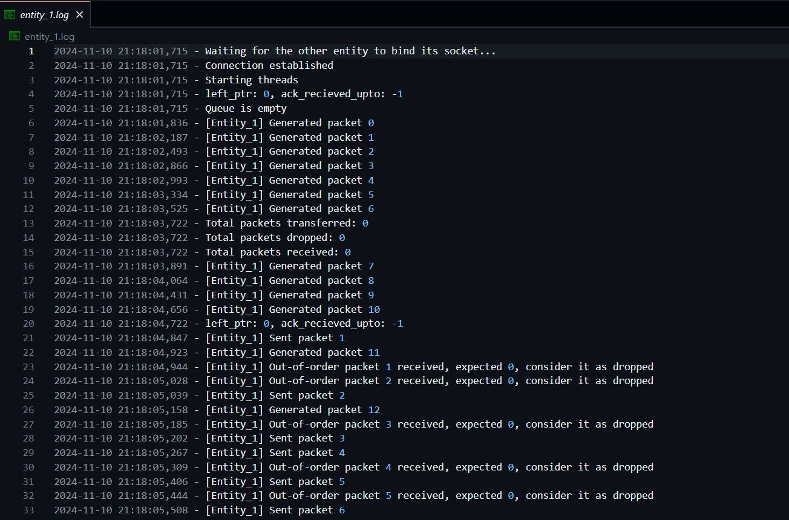
Outputs

Slide 8
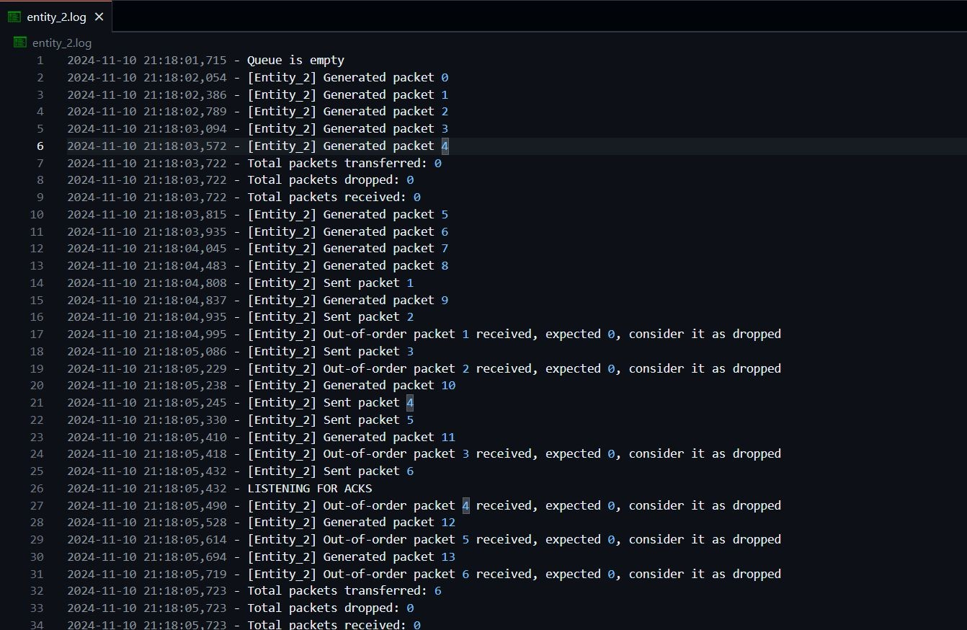
Outputs

Slide 9
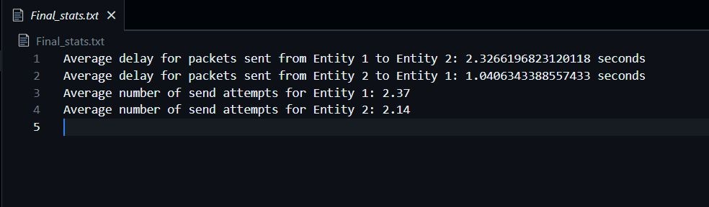
Result

Slide 10
References
https://www.topcoder.com/thrive/articles/implementing-go-back-n-protocol-in-c#:~:text=What%20is%20Go%20Back%2DN,window%20size%20is%20always%20one.
Tanenbaum’s book.
Computer Network Slides By Prof. BN Jain
Gpt4o for some debugging and formatting the Document Properly.

Slide 11
THANK
YOU

